Slide 1
Optimal (D−J)-monotonic priority assignment
Areej Zuhily, Alan Burns
Information Processing Letters 103 (2007) 247–250
Presenter: Chia-Hung Chang
Date: July 11, 2007

Slide 2
Introduction
rate monotonic v.s. deadline monotonic
release jitter
the maximum deviation of successive task releases from its period

Slide 3
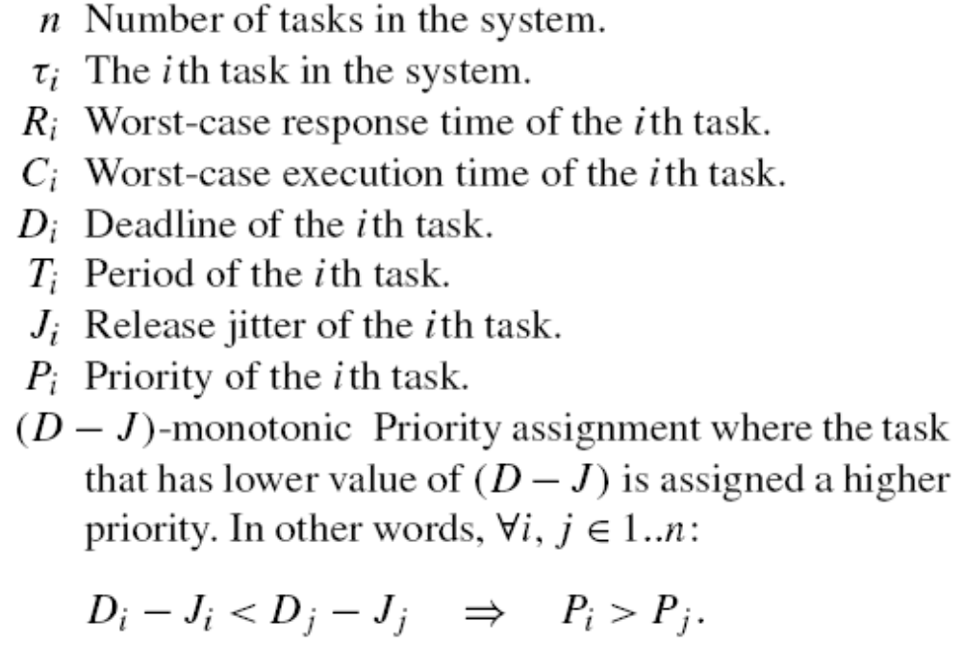
Notation

Slide 4
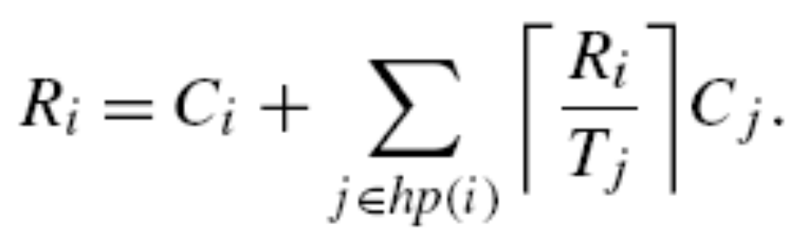

Feasibility analysis

Slide 5
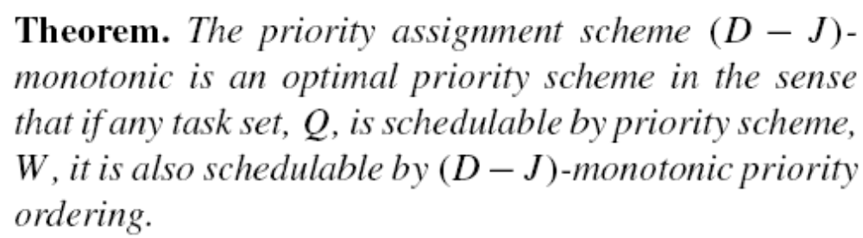
Optimality of (D − J)-monotonic
prove the optimality

Slide 6
Prove
Assume
If it is not possible to find this property then the tasks are already in (D − J) order

Slide 7
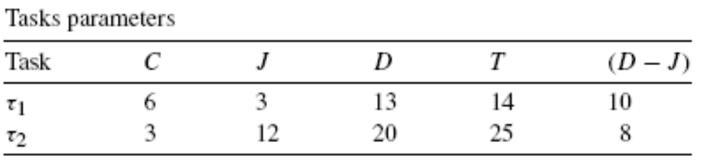
Example

Slide 8
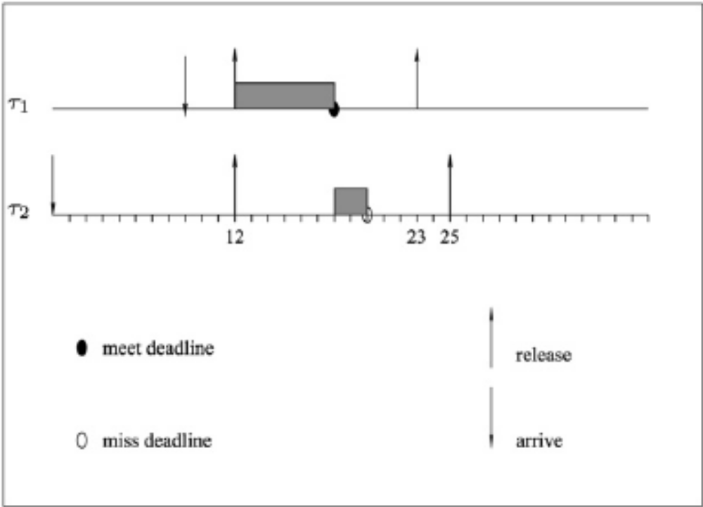

Slide 9
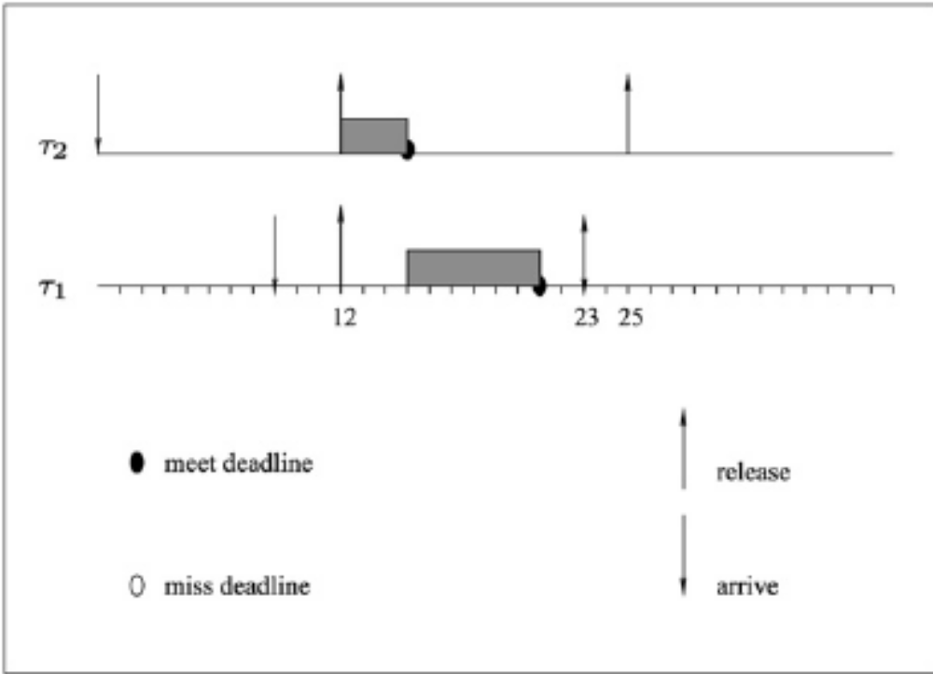

Slide 10
Conclusion
(D − J)-monotonic is an optimal fixed priority policy when release jitter is present

